Slide 1
Project Poseidon
Dhaval Patel [ 200439819 ]

Slide 2




UN Sustainable Development Goals
Goal 6 - Clean water and sanitation
Goal 3 – Good Health and Well-Being
Ensure access to water and sanitation for all
Ensure healthy lives and promote well-being for all at all ages.
Goal 17 – Partnerships for Goals
Goal 11 – Sustainable Cities and communities
Revitalize the global partnership for sustainable development
Make Communities inclusive, safe, resilient and sustainable

Slide 3

MVP 3
Implemented MVP 3 tasks
MVP 3
Plotting the map
MVP 2
16th June 2021
Sprint 3
9th June 2021
Status for MVP 2
MVP 1
2nd June 2021
19th May 2021

Slide 4
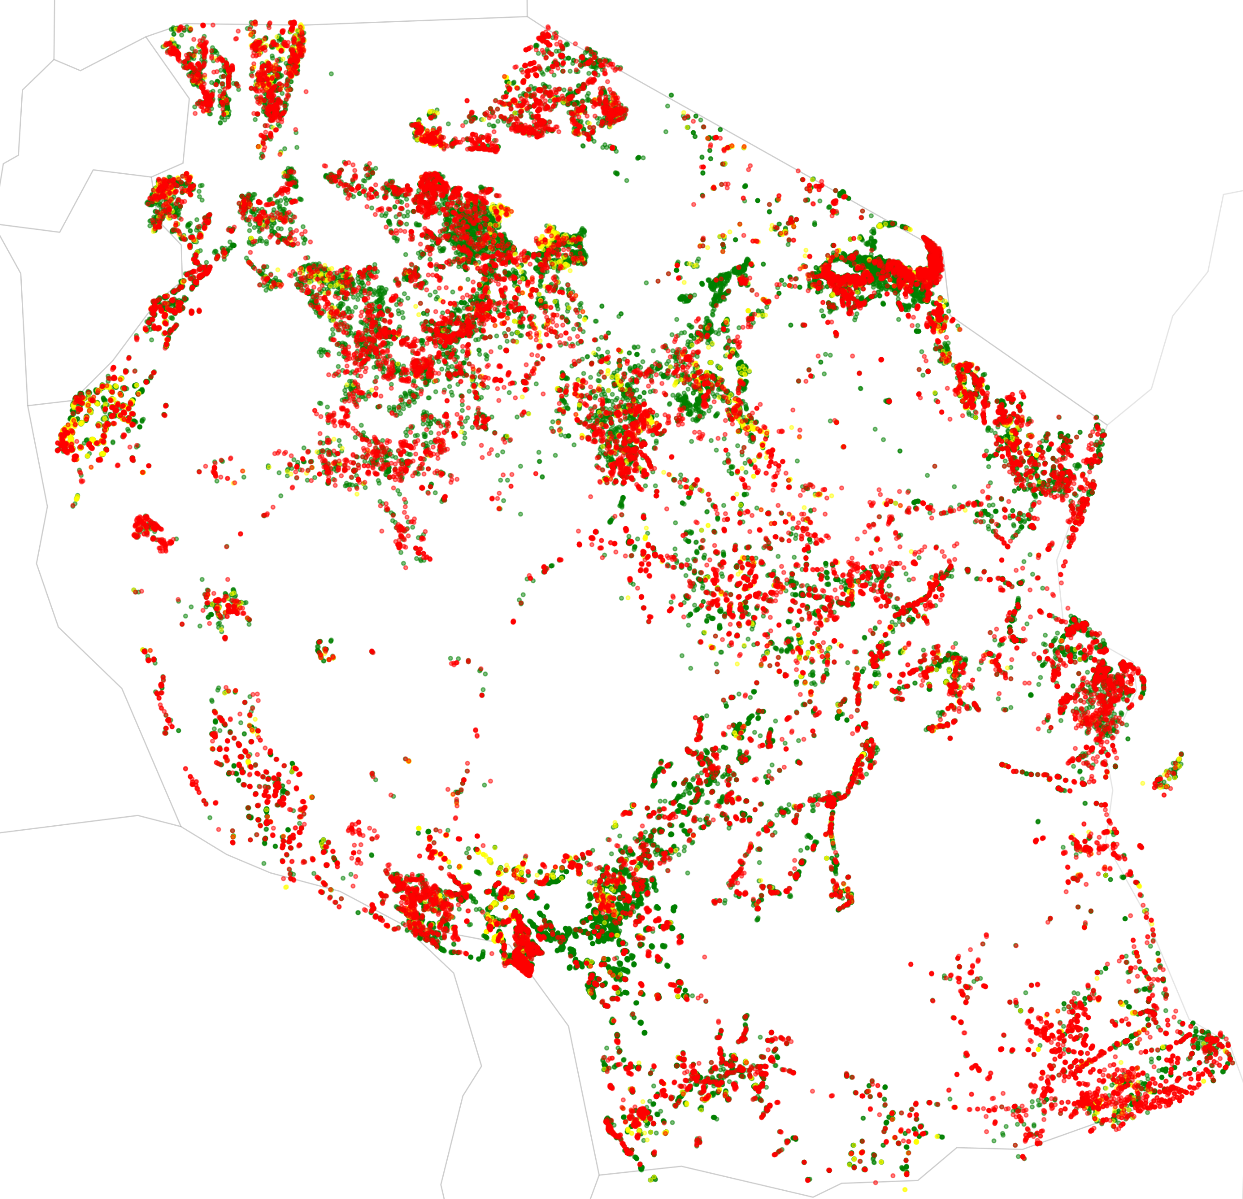

Slide 5
Reflection
MVP 3
My experience with the class was a rollercoaster ride with a steep learning curve.
The things I like include
Getting experience with webapp development using Django
Enhance my data science skill
Work on real time problem
What went well in the project
Development of model with high accuracy
Deploying the model for global reach
What not went well in the project
Designing Few functionality plunge me into chaos domain
MVP 2
16th June 2021
MVP 1
9th June 2021
2nd June 2021
19th May 2021
Overall MVP Status

Slide 6
Reflection
MVP 3
Concepts used from class
Stewardship
Separating the concerns
Mis information handling
Digital Habitat
Agile SDLC model
Data concepts
Customer adaption to technology
MVP 2
16th June 2021
MVP 1
9th June 2021
2nd June 2021
19th May 2021
Overall MVP Status

Slide 7
Future work
Chat forum
Announcement page for NGO
Live sensor data integrated to provide real time status prediction
Donate page for community
Award page
Deploying a full scale model
Increase robustness by in-cooperating data from other communities
Future MVP
MVP 3
16th June 2021
MVP 2
MVP 1
2nd June 2021

Slide 8
Thank you
Questions ?

